Slide 1
What Is Unit Testing?
​

Slide 2
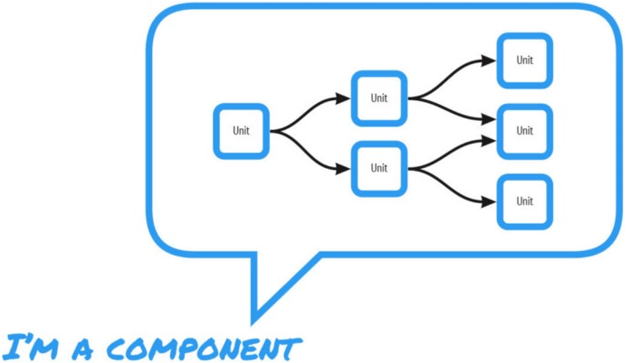
What Is Unit Testing?

Slide 3
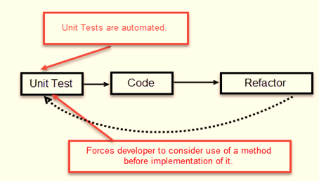
Unit Testing purpose

Slide 4
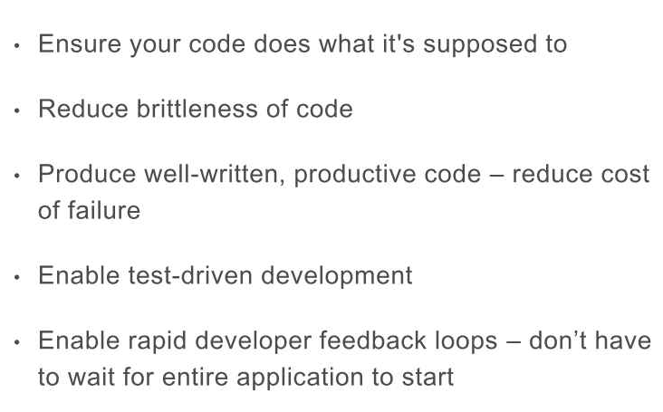
Unit Testing purpose

Slide 5
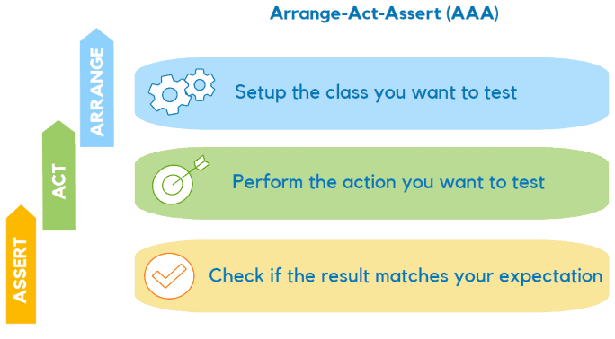
Parts of a good test

Slide 6
Some best practices
Write appropriate test names
Create simple tests
Address a single use-case
Look for maximum test coverage
Design unit tests to be as fast as possible
Minimize test dependencies
Adopt test automation

